Slide 1

Professional IP Solutions for
IP Professionals!
www.simgeip.com

Slide 2

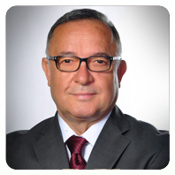
history
Simge IP was founded in 1998 by İbrahim Coskun, a chemical engineer.
While working as a chemist specialising in the protection of intellectual property rights in an international chemical company, Mr. Coskun became particularly skilled in developing filing strategies.
In the early years, due to his experience in the chemical sector, Simge IP provided domestic services in the field of chemical patents.

Slide 3
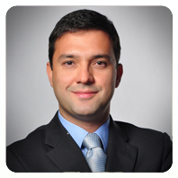
history
Then, Murat Cevahir Coskun, a lawyer, Turkish patent and trademark attorney and European Patent Attorney, joined the company and the company started to grow.
During this period, the current concept of Simge IP was developed and put into practice, in order to meet the need for an IP agency that would only serve IP agencies based abroad.

Slide 4
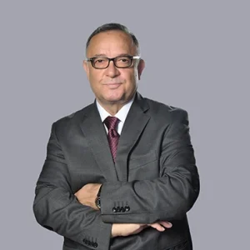
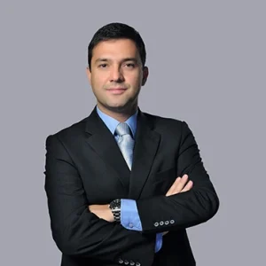
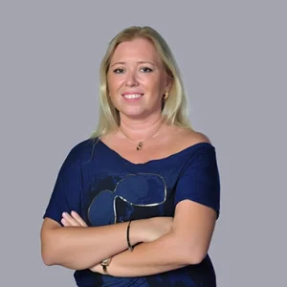
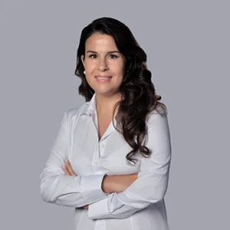
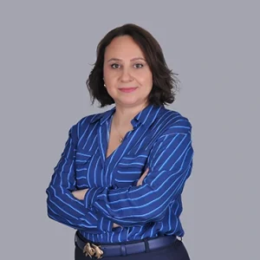
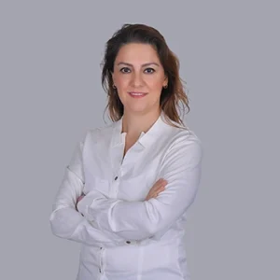
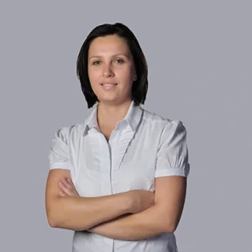
team
Today, Simge IP works as a team, each of which is specialised in his/her field and focused exclusively on serving international IP proxy firms.

Slide 5
concept
Simge Intellectual Property is a boutique IP agency dedicated to providing professional IP services to international IP firms in Turkiye, with a focus on Europe and China.
Our target audience consists solely of foreign patent and trademark attorneys outside Turkiye. We do not provide services to local companies, individuals, or organisations in Turkiye.
The main purpose of our business model is to provide high-quality service at a lower cost by focusing exclusively on the needs of IP professionals.

Slide 6
As a professional-to-professional service provider, we understand the unique needs and challenges faced by global IP firms.
Our team of experienced attorneys and consultants is committed to offering tailored, strategic advice and support, leveraging our extensive knowledge of both local and international IP landscapes.

Slide 7
As we are not serving local applicants and organisations,
We can reduce staff and operating costs: This allows us to offer specialised services with a smaller, more professional team, which reduces attorney fees.
We provide better quality service: Our team comprises specialists equipped to meet the needs of global IP professionals, so by focusing on specific areas, we can maintain a higher service quality. Our team is not distracted by local applications or customers and can concentrate solely on serving European and Chinese IP companies.

Slide 8
services
Prosecution and Litigation for patent, utility model, trademark and design rights,
Preparation of Enforcements,
EP validation applications,
PCT - national phase applications,
Madrid Protocol (Provisional Refusals from the TPTO),
Design - Hague agreement (Priority Document submissions, Office actions)

Slide 9
Invalidation procedures, oppositions, appeals against the decision of refusal,
A request for appeal against the decision of rejection by TPTO and IP High Court,
Administrative Case as a appeals against a decision of rejection and appeals for opposition and invalidation,
Technology transfer, Comprehensive patent-related management consultation,
Annuities and renewals,
English communication by online meeting.

Slide 10
translation
Our in-house translation department specialises exclusively in patent translations and is managed by translators specialised in the relevant fields and external consulting engineers.

Slide 11
external consultants
Our office works with engineers and lawyers specialised in IP area as external consultants to ensure flexibility and affordable pricing.

Slide 12
reciprocity
Patent applications in Turkiye : 6,500 in 2022 and 7,700 in 2023.
PCT applications from Turkiye : 1,700 in 2022 and 1,900 in 2023.
EP application from Turkiye : 560 in 2022 and 600 in 2023.
EP validation req. from Turkiye : 172 in 2022 and 234 in 2023.

Slide 13
As these numbers show, Turkey is not a major producer of inventions but needs to provide specialised services to global IP companies in foreing countries.
It is realistic to want to work with large IP firms that receive a large number of patent and trade mark applications in their home country in order to obtain reciprocal filings. This is efficient for countries with a high number of international IP requirements.

Slide 14
However, for countries such as Turkey, where the volume of PCT, EP and international trademark applications is very low, working with large IP attorney firms means paying much higher attorney fees for the same work.
This is because these firms have to pay high personnel and operational costs in order to reach their domestic IP clients and manage their domestic IP files, and this will be reflected in their attorney fees.
So, why pay more if you do not get reciprocal work!

Slide 15


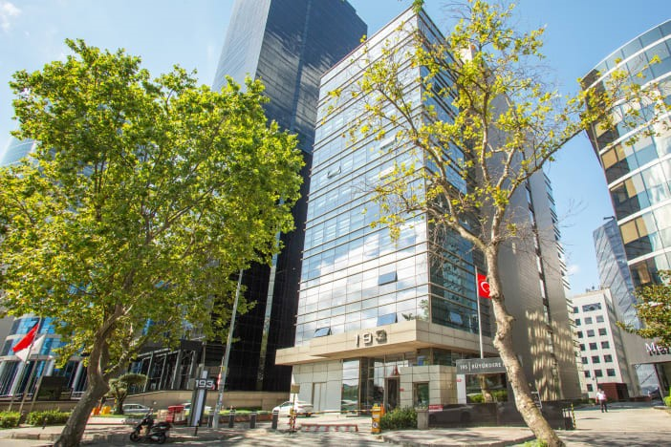
Office
Levent, Buyukdere C. No.193 F.2 Sisli, Istanbul, 34330 Turkiye
T: + (90) 212-371-4706
F: + (90) 212-329-7905
E: simge@simgeip.com
W: www.simgeip.com

Slide 16
We thank you for your cooperation

